Slide 1
Domain Controlled Multi-cell RNN
20155134 Jun oh Lee
20155064 Jin Woo Nam
20155009 Jabin Koo

Slide 2
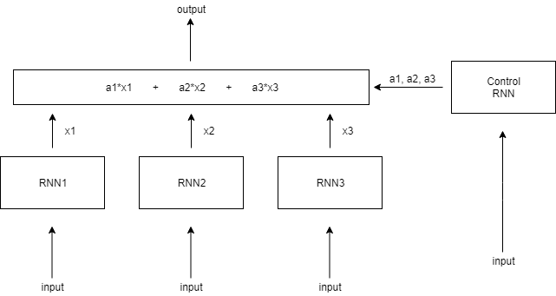
Introduction
Domain Controlled Multi-cell RNN(DCMRNN)

Slide 3
Motivation
To breakthrough limitation of hidden size in RNN Model
To make more efficient RNN model in terms of parameters and memory

Slide 4
Model
Domain Controlled Multi-cell RNN(DCMRNN)

Slide 5
Loss Function
Objective 1
- Make one weight a significant
Objective 2
- Distribute cell usage equally

Slide 6
Experiment
Dataset
- Movie-review polarity dataset by Pang et al.
experiment

Slide 7
Conclusion

